Slide 1

CSC403 Blockchain Architecture and Design-II
Lecture #0
The kick start session

Slide 2
Course details
LTP – 2 0 2 [Two lectures/week]
Text Book:
MASTERING BLOCKCHAIN by LORNE LANTZ AND DANIEL CAWREY, O'reilly Media
Reference Book
ETHEREUM SMART CONTRACT DEVELOPMENT: BUILD BLOCKCHAIN-BASED DECENTRALIZED APPLICATIONS USING SOLIDITY by MAYUKH MUKHOPADHYAY, PACKT PUBLISHING

Slide 3
Course Assessment Model
MARKS BREAK UP
Attendance 5
CA (Two best out of three CA) 25
Mid Term Exam (MTE) 20
End Term Exam (ETE) 50
Total 100

Slide 4
Course Outcomes
Through this course, students should be able to:
CO1 :: understand advanced concepts of blockchain architecture and design
CO2 :: discover security vulnerabilities in smart contracts in order to mitigate them
CO3 :: apply security best practices in blockchain applications
CO4:: analyze the importance of security in decentralized finance
CO5:: explore advanced topics and emerging trends in blockchain technology
CO6:: demonstrate the deployment of secure smart contracts

Slide 5
Program Outcomes for CSC306
PO-1:Engineering knowledge::Apply the knowledge of mathematics, science, engineering fundamentals, and an engineering specialization to the solution of complex engineering problems.
PO-2: Problem analysis::Identify, formulate, research literature, and analyze complex engineering problems reaching substantiated conclusions using first principles of mathematics, natural sciences, and engineering sciences.
PO-3:Design/development of solutions::Design solutions for complex engineering problems and design system components or processes that meet the specified needs with appropriate consideration for the public health and safety, and the cultural, societal, and environmental considerations.
PO-4:Conduct investigations of complex problems::Use research-based knowledge and research methods including design of experiments, analysis and interpretation of data, and synthesis of the information to provide valid conclusions.
PO-5: Modern tool usage::Create, select, and apply appropriate techniques, resources, and modern engineering and IT tools including prediction and modeling to complex engineering activities with an understanding of the limitations

Slide 6
PO-6:The engineer and society::Apply reasoning informed by the contextual knowledge to assess societal, health, safety, legal and cultural issues and the consequent responsibilities relevant to the professional engineering practice.
PO-8:Ethics::Apply ethical principles and commit to professional ethics and responsibilities and norms of the engineering practice.
PO-9:Individual and team work::Function effectively as an individual, and as a member or leader in diverse teams, and in multidisciplinary settings.
PO-10:Communication::Communicate effectively on complex engineering activities with the engineering community and with society at large, such as, being able to comprehend and write effective reports and design documentation, make effective presentations, and give and receive clear instructions.
PO-11: Project management and finance::Demonstrate knowledge and understanding of the engineering, management principles and apply the same to one’s own work, as a member or a leader in a team, manage projects efficiently in respective disciplines and multidisciplinary environments after consideration of economic and financial factors.
PO-12: Life-long learning::Recognize the need for, and have the preparation and ability to engage in independent and life-long learning in the broadest context of technological change.
PO-13: Competitive Skills::Ability to compete in national and international technical events and building the competitive spirit

Slide 7
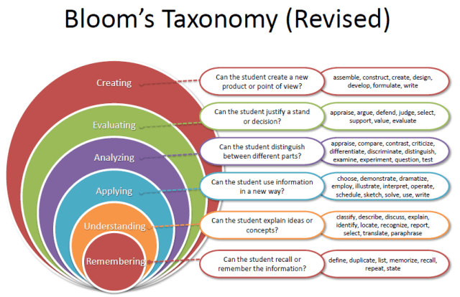
Revised Bloom’s Taxonomy

Slide 8
CA Details
1. CA1(BYOD practical )
Rubrics: Job Evaluation -15 marks and Viva -15 marks
2. CA2(BYOD practical )
Rubrics: Job Evaluation -15 marks and Viva -15 marks

Slide 9

The hitch…
The three BURNING questions in mind…
Why are we learning Blockchain architecture and design-II?
What would we do with it?
What will be the course outcome?

Slide 10
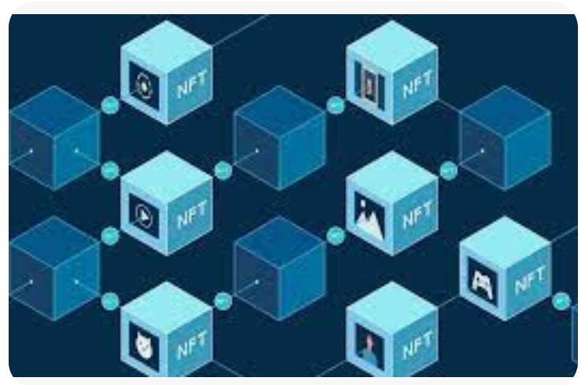
Why Blockchain architecture and design-II?

Slide 11
Why Blockchain architecture and design-II?
understand the basic architecture of blockchain
identify the use cases for implementation in blockchain
develop blockchain applications for various use cases

Slide 12
Unit I
Advanced blockchain concepts
Review of basic blockchain concepts
Deep dive into blockchain
Consensus algorithms (Proof of Work, Proof of Stake, Delegated Proof of Stake, Byzantine Fault Tolerance)
Scalability solutions: Sharding, layer 2 solutions (e.g., Plasma, Rollups)
Blockchain interoperability: cross-chain communication and atomic

Slide 13
UNIT II
Smart contract security
Introduction to smart contract security
Common vulnerabilities in smart contracts: reentrancy attacks, integer overflow/underflow, front-running, timestamp dependence, denial of service
Tools for smart contract security analysis: MythX, Slither, Oyente
Best practices for writing secure smart contracts
Case studies of notable smart contract security breaches and lessons
learned

Slide 14
UNIT III
Advanced Solidity programming
Advanced data structures in Solidity: Structs, mappings, nested mappings, enums
Design patterns for secure smart contracts: Checks-Effects-Interactions, Circuit Breaker, Emergency Stop, Pull over Push
Writing and testing upgradable smart contracts
Using oracles in smart contracts for off-chain data integration
Advanced testing techniques: unit testing, integration testing, fuzz testing

Slide 15
UNIT IV
Formal verification and auditing
Introduction to formal verification of smart contracts
Using formal verification tools (e.g., K Framework, Dafny) to prove contract correctness
Conducting smart contract audits: manual review and automated tools
Writing comprehensive audit reports
Third-party auditing services and certifications

Slide 16
UNIT V
Decentralized Finance (DeFi) security
Overview of DeFi and its ecosystem
Security considerations in DeFi applications: Liquidity pools, decentralized exchanges, lending protocols
Analyzing DeFi hacks and vulnerabilities
Implementing secure DeFi protocols
Regulatory considerations in DeFi

Slide 17
UNIT VI
Emerging trends and future directions
Privacy in blockchain: Zero-Knowledge Proofs, zk-SNARKs, zk-Rollups
Blockchain governance models and security implications
Quantum computing and its potential impact on blockchain security
Exploring new blockchain platforms and technologies (e.g., Polkadot, Cosmos, Tezos)
Future directions in blockchain research and development

Slide 18
OPEN EDUCATIONAL RESOURCES
1. Introduction to blockchain concepts
https://www.ibm.com/topics/blockchain
2. Ethereum Development
https://ethereum-blockchain-developer.com/
3. Ethereum and Solidity developer
https://www.udemy.com/course/ethereum-and-solidity-the-complete-developers-guide/

Slide 19
Career Prospects
Blockchain Developer
Blockchain Security Engineer
Blockchain Security Analyst

Slide 20

EDU Revolution: Be the Change
New Year
New Beginning
New Excitement

Slide 21
What's New
Good Bye to old fashioned teaching and evaluation and let’s embrace the new paradigm Edu-Revolution: - Be the Change
Register to avail Privileges and benefits for the following Initiatives
A. Course Equivalence and Attendance Relaxation
B. Grade Revision and Overall Welfare (GROW)
C. 10 % Attendance waiver for students in Pre-final/Final year of the programme
D. Continuous Assessment Reduction Through Experience (CARE)
E. Students in active decision-making through Student Committees

Slide 22
Course Equivalence and Attendance Relaxation
Recognition of Prior Learning (RPL)
NPTEL Course/MOOCs/Certifications
Pursuing Project
Any other: In addition to above, the students may also suggest any additional aspect with regard to which the student is seeking course equivalence and attendance relaxation in the upcoming term

Slide 23
Recognition of Prior Learning (RPL)
Inform students about the concept of recognition of prior learning for basic elementary courses such as English, Mathematics, Analytical skills, Soft skills

Slide 24
NPTEL Course/MOOCs/Certifications
Enlist the MOOCs/Certifications applicable for the course
Encourage students to register for NPTEL/MOOCs/Certifications
Discuss the benefits associated with these courses (course equivalence and attendance relaxation)

Slide 25
Projects
Enlist short live projects that can be undertaken by the students
Guide students about the outcomes of the projects like Patent/Copyright/Publication/Industry funding/ Government sponsorship (like ATAL Innovation Mission)

Slide 26
Grade Revision and Overall Welfare (GROW)
Enlist applicable national/international competitions/hackathons of repute and guide the students about opportunity to improve their existing grades through their involvement

Slide 27
Attendance Relaxation (only for Pre-final/Final year of the programme)
Students with a CGPA of 8 or higher can apply for an attendance relaxation in their pre-final/final year. Eligible students will be granted a 10% attendance relaxation to support their career development for pursuing the following aspirations like:
Preparation of Competitive Exam
Preparation of Technical Competition
Freelancing Activity/Entrepreneurship/ Revenue Generation
Industry/ Field Project
Consultancy Project

Slide 28
Continuous Assessment Reduction through Experience (CARE)
Brief introduction of the continuous assessment of the course.
Students must be made aware of the CA modification that can be applicable to the course.
Identify innovative CA models like real life problems, surveys live projects etc.
State examples of real-life problems that can be taken up for the course.

Slide 29
Students in active decision-making through Student Committees
Students will be actively involved in decision-making related to academic and learning procedures applicable to them, by becoming a member of various committees as listed below:
Student Academic and Project Review Committee
Student Career Committee
Student entrepreneurship and Media Committee

Slide 30
Interfaces and Contact Information
UMS link to apply for EDU Revolution initiatives:
UMS Navigation --- LMS → EDU Revolution: BE THE CHANGE
In case of any query in this regard the student can approach for resolution through RMS at the following path:
UMS Navigation--- Relationship management system → EDU Revolution: BE THE CHANGE
OR get your queries resolved through the Helpline Number: 01824-520150.

Slide 31

The End

